Slide 1
Looking for a roommate
Basic 04 – Unit 10 a -Housing

Slide 2
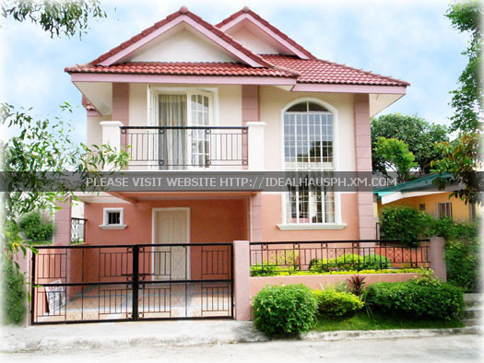

Slide 3


Ask about :
Chairs in the dining room
A table in the kitchen
Bedrooms (Number)
A big kitchen?
Shower or bathtub
Lamps in the bedrooms
Supermarkets near the house
A garage
A fridge
A big closet
A bed
Furniture in the apartment

